Slide 1
Selling Against the Hype of
New Mediums and Social Media
Parker Slaybaugh
Chris Lagey
Walter Scott

Slide 2
Publicity
;
Especially promotional publicity of an extravagant or contrived kind

Slide 3
What New Mediums
And Social Media?

Slide 4
Social Media
No/Low Cost of Entry
Direct Communication
Going Viral
Flexibility
Not Yours!
Unlevel Playing Field
Confusing Costs
Time Consuming
Going Viral

Slide 5
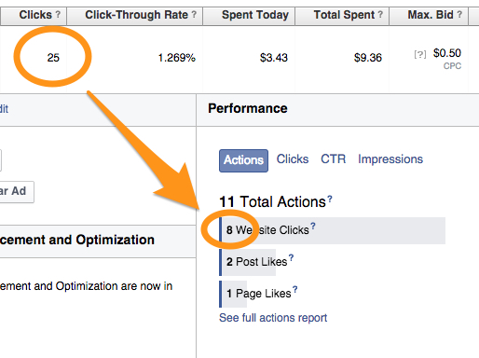

Slide 6
Audio
Unlimited Library of Music
Accessible 24/7
Easy to Use
Targeted Advertising
Inflated Reach
No Local Content
Local Ads Not Guaranteed
Inaccurate Metrics

Slide 7
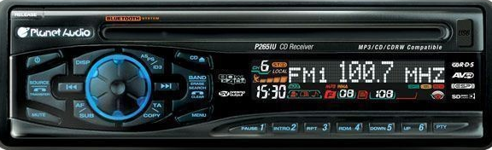
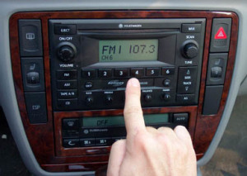
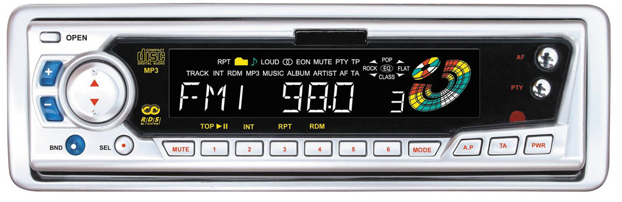
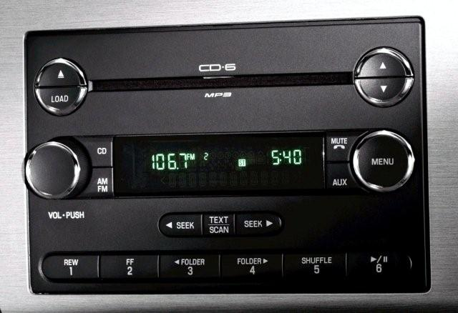
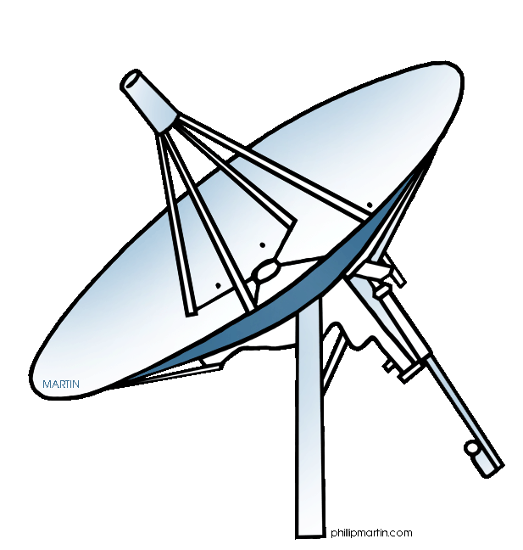
Radio
93%

Slide 8
Video
Instant Access
Unlimited Content
Available on Multiple Screens
Portable
No Internet/No Access
Fragmented Audience
Limited Advertising Opportunities
No Local Content

Slide 9
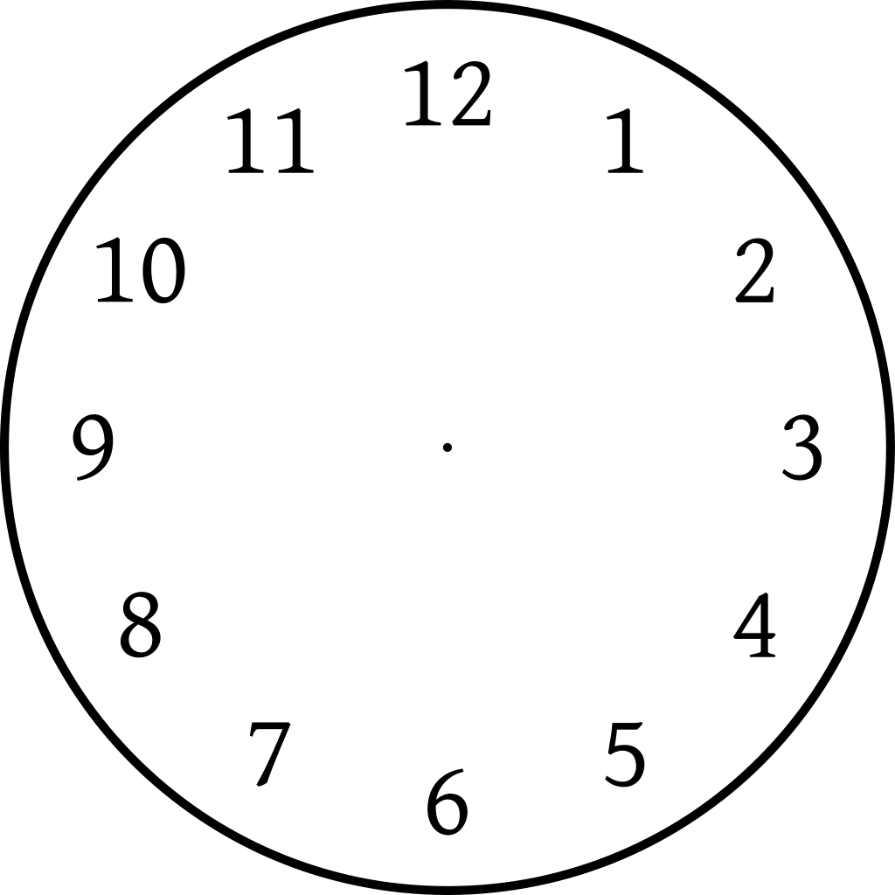
Television
65%
34
LOCAL
LOCAL
LOCAL

Slide 10
Selling Against
The Hype
Right off a Cliff | 99,000 Followers | 1-3% See his Post | 1,000-3,000 people | Free
Right off a Cliff | 99,000 Followers | 29%-76% See His Post | 29,000-76,000 People | $150 -1 Post

Slide 11
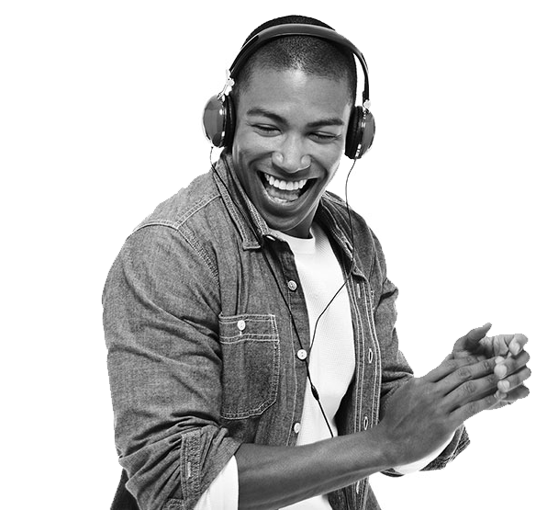
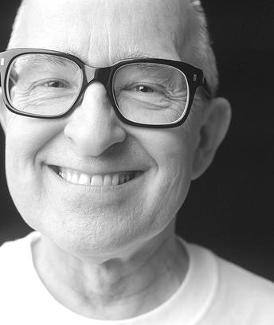
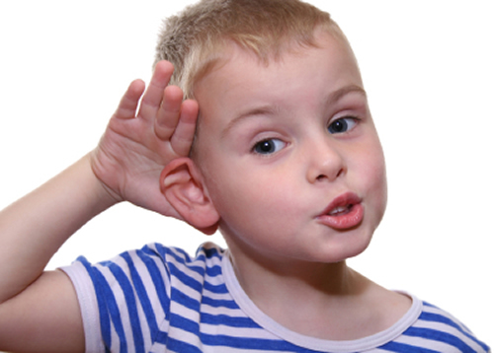
What Do We Sell?

Slide 12
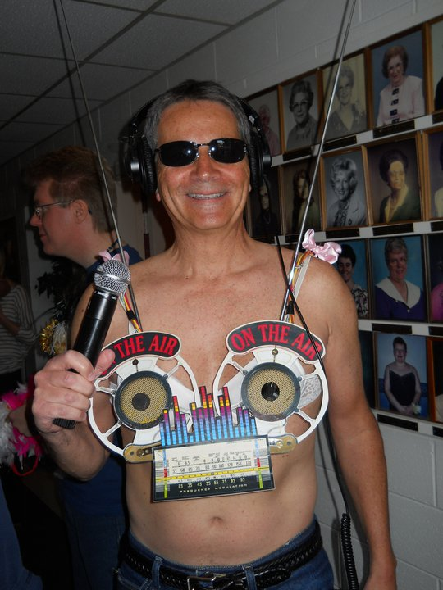
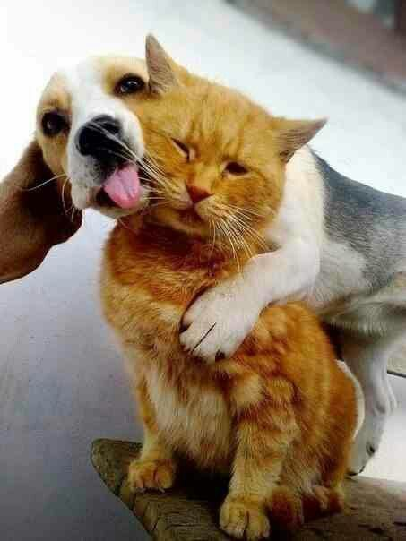
Selling Against The Hype

Slide 13
Thank You!

